Slide 1

Assessment Feedback (Quiz)

Slide 2
Week 7 Quiz – 5% of overall marks (Quizzes are 20%)

Slide 3
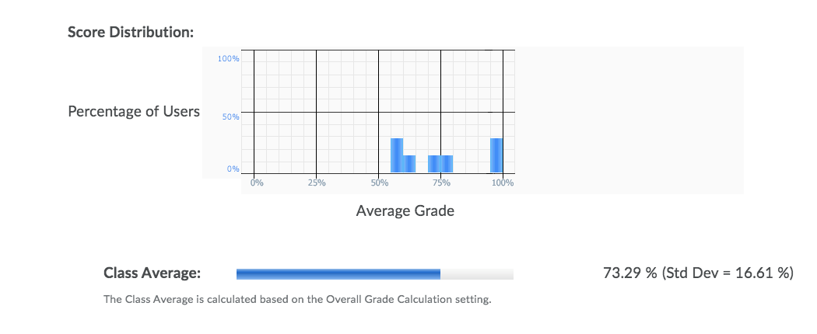
The spread of the grades looked as following:

Slide 4
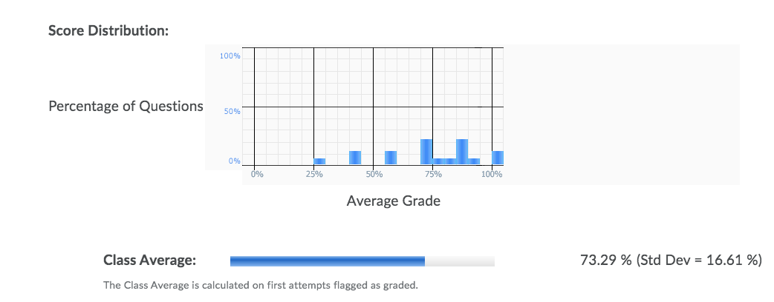
The question statistics looked like this:

Slide 5
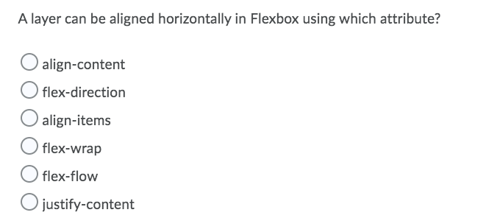
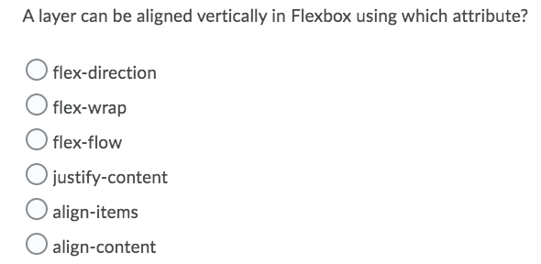
The five weakest answered questions were..

Slide 6
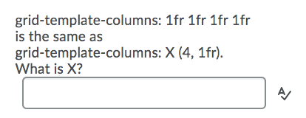
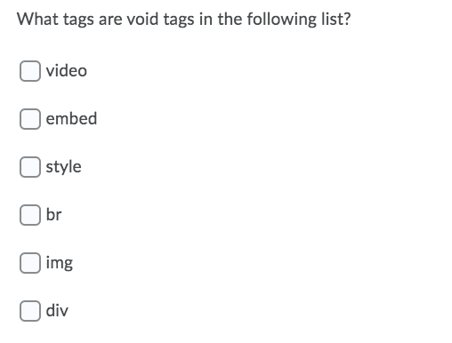
The five weakest answered questions were..

Slide 7

Revision for this week’s quiz

Slide 8
Blog Feedback
Week 1 Average: 87% (Highest – 100%)
Week 2 Average: 84% (Highest – 100%)
Week 3 Average: 93% (Highest – 100%)
Week 4 Average: 87% (Highest – 100%)
Overall Average: 88%

